Slide 1

Introduction to Web Development

Slide 2
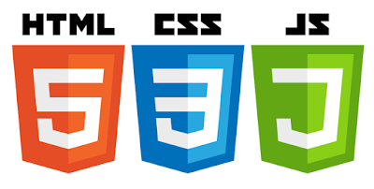
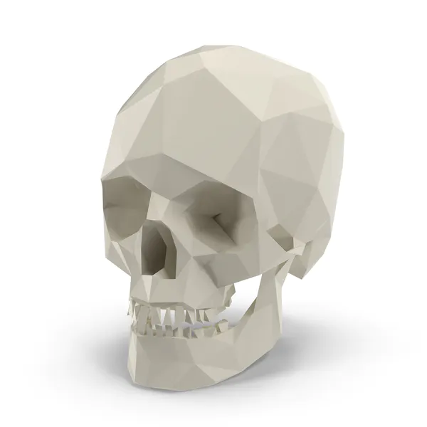


Introduction
Introduction to web technologies:
HTML to create the document structure and content
CSS to control visual aspect
Javascript for interactivity

Slide 3

Tools
What do we need to start:
A good web-browser (Chrome, Edge or Safari)
A good text editor like:
VSCode (cross platform - Preferred)
Notepad++ (win)
sublime text (cross platform)

Slide 4

How can I test my code
Just open the index.html from the template in your text editor and in your browser.
When you do any change to the code, check it in the browser by pressing F5 (refresh site)
To open the developer tools press:
Windows: Control + Shift + I or
OSX: Command + Opt + I

Slide 5
Introduction to HTML

Slide 6
Definitions
WWW – World Wide Web.
HTML – Hypertext Markup Language –
The Language of Web Pages on the World Wide Web.
HTML is a text formatting language.
URL – Uniform Resource Locator.
Browser – A software program which is used to show web pages.

Slide 7
What is HTML?
HTML is short for Hypertext Markup Language.
HTML is a computer language that is used to create documents on the Word Wide Web.
It simply means it is a language for describing web-pages using ordinary text.
HTML is very simple , and logical. It reads from left to right, top to bottom and uses plain text.
HTML is NOT a programming language, but a markup-up language that uses <Tags> like this.
The websites you view on the internet are text files that consist of HTML Tags.
All HTML documents must start with a type declaration: <!DOCTYPE html>.
The HTML document itself begins with <html> and ends with </html>.
The visible part of the HTML document is between <body> and </body>.

Slide 8
What is HTML?
“Normal text” surrounded by bracketed tags that tell browsers how to display web pages
Pages end with “.htm” or “.html”
HTML Editor – A word processor that has been specialized to make the writing of HTML documents more effortless.
Every web page is a HTML file.
Each HTML file is just a plain-text file, but with a .html file extension instead of .txt, and is made up of many HTML tags as well as the content for a web page.
A web site will often contain many html files that link to each other

Slide 9
HTML TAGS
HTML markup tags are usually called HTML tags
HTML tags are keywords surrounded by angle brackets like <html>
HTML tags normally come in pairs like <b> and </b>
The first tag in a pair is the start tag, the second tag is the end tag
Start and end tags are also called opening tags and closing tags
For example, <html> is the opening tag and </html> is the closing tag. Note that the closing tag has the same text as the opening tag, but has an additional forward-slash ( / ) character.
The purpose of a web browser (Chrome, Edge, Firefox, Safari) is to read HTML documents and display them.
HTML tags are the hidden keywords within a web page that define how the browser must format and display the content.
The browser does not display the HTML tags, but uses them to determine how to display the document:

Slide 10
HTML TAGS
Codes enclosed in brackets
Usually paired
<title>My Web Page</title>
Not case sensitive
<title> = < TITLE >

Slide 11
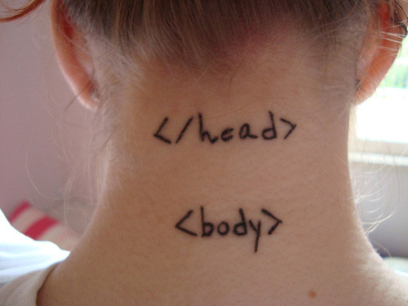
Creating a First HTML Page
<HTML>
<HEAD>
<TITLE>My University</TITLE>
</HEAD>
<BODY>
This is what is displayed.
</BODY>
</HTML>

Slide 12
Creating a First HTML Page
The HEAD of your document point to above window part.
The TITLE of your document appears in the very top line of the user’s browser.
If the user chooses to “Bookmark” your page or save as a “Favorite”; it is the TITLE that is added to the list.
The text in your TITLE should be as descriptive as possible because this is what many search engines, on the internet, use for indexing your site.

Slide 13
Headings, <Hx> </Hx>
Inside the BODY element, heading elements H1 through H6 are generally used for major divisions of the document.
Headings are permitted to appear in any order, but you will obtain the best results when your documents are displayed in a browser if you follow these guidelines:
H1: should be used as the highest level of heading, H2 as the next highest, and so forth.
You should not skip heading levels: e.g., an H3 should not appear after an H1, unless there is an H2 between them.
<HTML>
<HEAD>
<TITLE> Example Page</TITLE>
</HEAD>
<BODY>
<H1> Heading 1 </H1>
<H2> Heading 2 </H2>
<H3> Heading 3 </H3>
<H4> Heading 4 </H4>
<H5> Heading 5 </H5>
<H6> Heading 6 </H6>
</BODY>
</HTML>
Heading 1
Heading 2
Heading 3
Heading 4
Heading 5
Heading 6

Slide 14
Paragraphs, <P> </P>
Paragraphs allow you to add text to a document in such a way that it will automatically adjust the end of line to suite the window size of the browser in which it is being displayed.
Each line of text will stretch the entire length of the window.

Slide 15
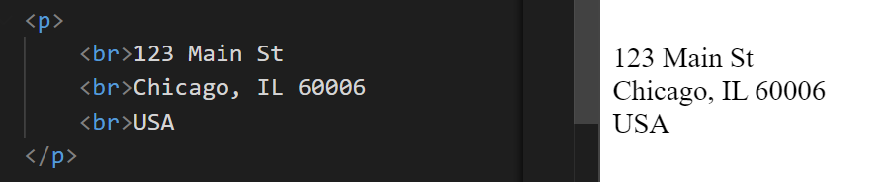
Break, <BR>
The <br> tag in HTML stands for "break" and is used to insert a line break in the text.
It is an empty tag, meaning it does not have a closing tag (aka void tag).
This tag is particularly useful when you want to start a new line without starting a new paragraph.
Here's a simple example:
<p>This is the first line.<br>This is the second line.</p>
It is useful for writing a poem or an address, where the division of lines is significant.

Slide 16
Horizontal Rule, <hr>
The <hr> element causes the browser to display a horizontal line (rule) in your document.
<hr> does not use a closing tag, </hr>
Aka void tag

Slide 17
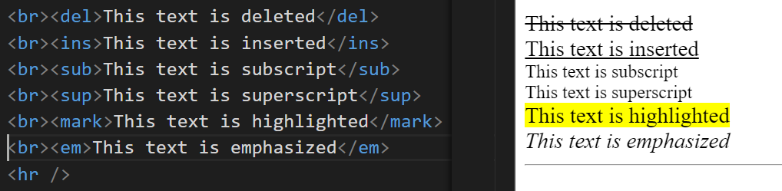
HTML Text Formatting Elements
The HTML <b> element defines bold text, without any extra importance
The HTML <strong> element defines strong text, with added semantic importance.
The HTML <i> element defines italic text, without any extra importance.
The HTML <em> element defines emphasized text, with added semantic importance.
The HTML <mark> element defines marked or highlighted text.
The HTML <del> element defines deleted (removed) of text.
The HTML <ins> element defines inserted (added) text.
The HTML <sub> element defines subscripted text.
The HTML <sup> element defines superscripted text.

Slide 18
HTML: basic rules
Some rules about HTML:
It uses XML syntax (tags with attributes, can contain other tags).
<tag_name attribute="value"> content </tag_name>
It stores all the information that must be shown to the user.
There are different HTML elements for different types of information and behaviour.
The information is stored in a tree-like structure (nodes that contain nodes inside) called DOM (Document Object Model).
It gives the document some semantic structure (pe. this is a title, this is a section, this is a form) which is helpful for computers to understand websites content.
It must not contain information related to how it should be displayed (that information belongs to the CSS), so no color information, font size, position, etc.

Slide 19
HTML: syntax example
<div id="main">
<!-- this is a comment -->
This is text without a tag.
<button class="mini">press me</button>
<img src="me.png" />
</div>
In HTML, a "div" (short for "division") is a generic container element used to group different sections of content on a webpage.
It allows you to style and organize elements together using CSS without any inherent semantic meaning.
Essentially, it acts as a box that can hold other HTML elements and be visually customized with styling rules.

Slide 20
HTML: syntax example
Tag name
<div id="main">
<!-- this is a comment -->
This is text without a tag.
<button class="mini">press me</button>
<img src="me.png" />
</div>
attributes
comment
text tag
self-closing tag

Slide 21
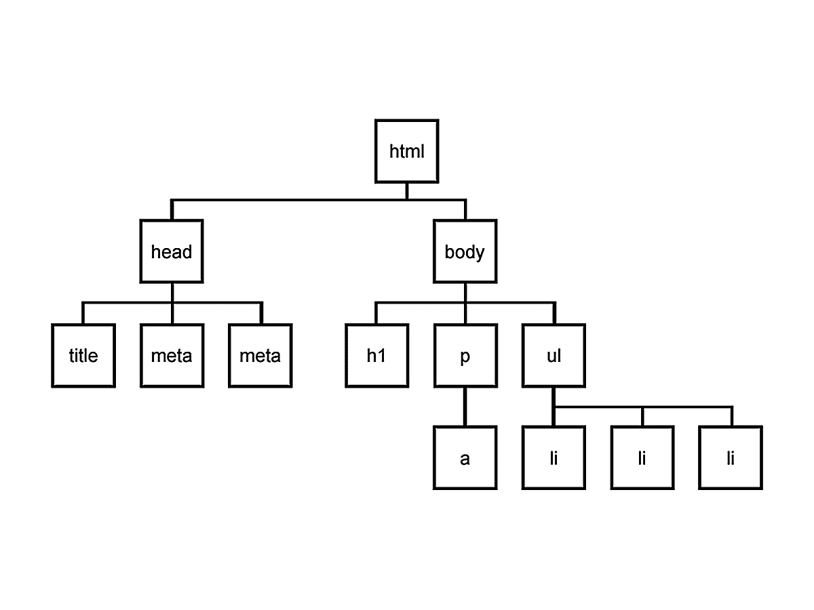
DOM is a tree
Every node can only have one parent, and every node can have several children, so the structure looks like a tree.

Slide 22
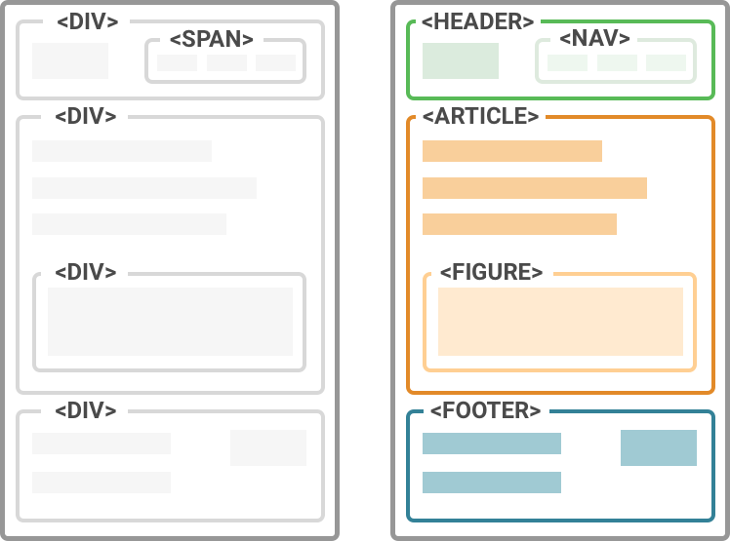
HTML: wrapping the info
We use HTML tags to wrap different information on our site.
The more structure has the information, the easier will be to access it and present it.
We can change the way the information is represented on the screen depending on the tags where it is contained, so we shouldn't be worried about using too many tags.

Slide 23
Introduction to CSS

Slide 24
What is CSS?
CSS stands for Cascading Style Sheets
Styles - define how to display HTML elements
Styles are normally stored in Style Sheets (with .css file extension)
HTML and CSS work together to produce beautiful and functional Web sites.
HTML= Structure
CSS= Style (appearance, color of fonts, alignment, background color etc)
Cascading Style Sheets (CSS) – is a rule based language that applies styling to your HTML elements.
You write CSS rules in elements, and modify properties of those elements such as color, background color, width, border thickness, font size, etc.

Slide 25
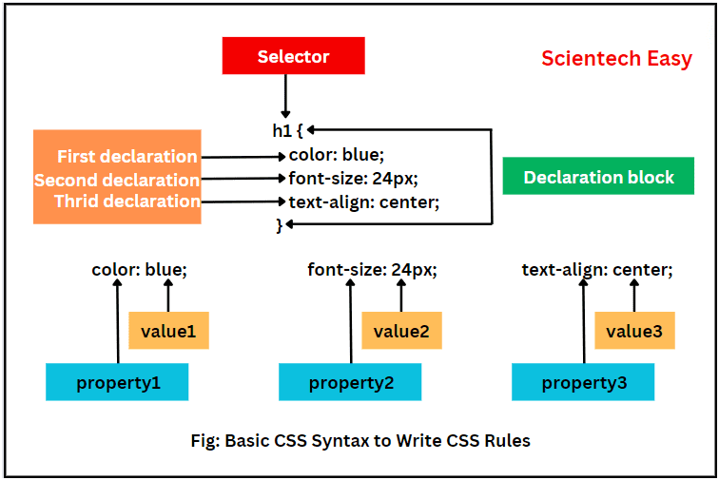
Syntax of CSS
The CSS syntax is made up of 5 parts:
selector
declaration block
declaration
property/value
curly braces
Selector identifies the HTML elements that the rule will be applied to, identified by the actual element name, e.g. <body>, or by other means such as class attribute values.
Image credit: https://www.scientecheasy.com/2024/05/css-syntax.html/

Slide 26
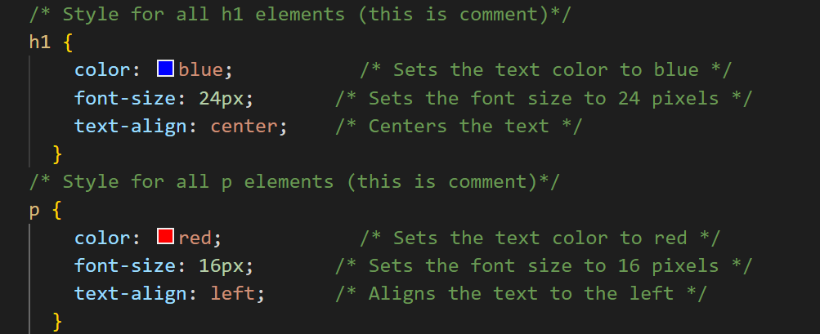
Syntax of CSS
The CSS syntax is made up of 5 parts:
Selector identifies the HTML elements that the rule will be applied to, identified by the actual element name, e.g. <body>, or by other means such as class attribute values.
Declaration block: multiple declaration lines including the curly braces.
Declaration: Each CSS line that includes property and value.
Each declaration consists of a property and a value.
Property/value: The property is the style attribute you want to change. Each property has a value.
Properties are separated from their respective values by colons :
Pairs are separated from each other by semicolons ;
Curly Braces: the curly braces contain the properties of the element you want to manipulate, and the values that you want to change them to. The curly braces plus their content is called a declaration block.

Slide 27
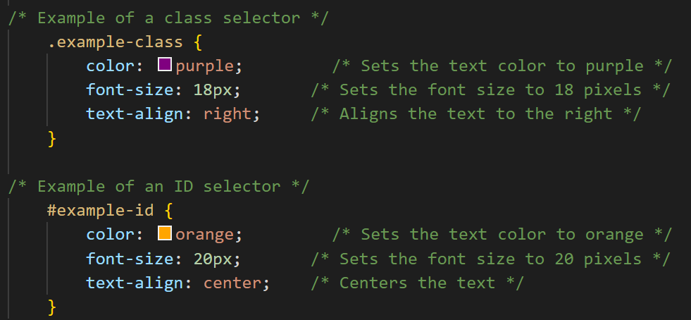
Class and id Selectors
In addition to setting a style for a HTML element, CSS allows you to specify your own selectors called "id" and "class".
id - The id selector is used to specify a style for a single, unique element.
The id selector uses the id attribute of the HTML element, and is defined with a "#"
The style rule below will be applied to the element with id="para1":
#para1 {text-align:center;color:red;}
Class - The class selector is used to specify a style for a group of elements.
Unlike the id selector, the class selector is most often used on several elements.
This allows you to set a particular style for any HTML elements with the same class.
The class selector uses the HTML class attribute, and is defined with a "."
In the example below, all HTML elements with class="center" will be center-aligned
.center {text-align:center;}
IDs (#) are unique and can only be used once on the page.
Classes ( . ) can be used as many times needed.
Notes:
. IDs (#) are unique and can only be used once on the page.
. Classes ( . ) can be used as many times needed.

Slide 28
Comments in CSS Files
Comments are used to explain your code.
Comments are ignored by browsers.
You add comments by enclosing them in /* and */
Comments can span several lines, and the browser will ignore these lines.
Example:
/* This is a basic comment it will not appear on the page*/
/* starts the comment
*/ is the end of the comment
/*This is a comment*/ p{ text-align:center; color:black; font-family:arial;}

Slide 29
How CSS is Applied to A Web Page
CSS is applied to a web page using three different methods:
External CSS (Recommended): Applies styles as a separate file with a .css extension.
The file is then referenced from inside the <head> element by a link to the file.
For Example:
<head>
<title>my external style sheet page</title>
<link rel=“stylesheet” href=“style.css”>
<body>
<p>this is a simple paragraph</p>
</body>
Inline CSS: Using the attribute style on a tag
Applies styles directly to the elements by adding declarations into the style
<p style="color: blue; margin: 10px">
Above is a simple paragraph and the inline style makes it blue
Internal CSS: Applies styles to HTML by placing the CSS rules inside the tag <style> inside the document tag <head>.
For Example:
<head>
<title>my page</title>
<style >p{color:red}</style>
</head>
<body>
<p>this is a simple paragraph</p>
</body>

Slide 30
How CSS is Applied to A Web Page
What style sheet is best?
External style sheets are best because they allow you to save all the style information on a separate file from the content.
You can then modify a style for a site, and it will update all of the pages in a site.
Internal and External style sheets are more popular because you can style multiple elements with one rule.
Web developers rarely use inline CSS. Since they prefer to not mix content with presentation.
It is not efficient since you have to declare the style individually for every component.

Slide 31
Colors and Formatting in CSS
CSS Colors
There are a few ways that you can set colors in CSS: Keywords, Hex values, RGB
CSS Colors: Keywords
Using the keywords like: red, fuchsia, yellow, blue, green you can specify what color you would like the CSS rule to display.
For example: p{color:red} or h2{color:yellow}
There are 17 of these keyword colors you can use in CSS.
Keyword Color | Hex
aqua | #00ffff
black | #000000
blue | #0000ff
fuchsia | #ff00ff
gray | #808080
green | #008000
lime | #00ff00
maroon | #800000
navy | #000080
olive | #808000
orange (added in CSS 2.1) | #ffa500
purple | #800080
red | #ff0000
silver | #c0c0c0
teal | #008080
white | #ffffff
yellow | #ffff00

Slide 32
Colors and Formatting in CSS
Computers are capable of displaying a lot more than 17 colors.
In fact they can display approximately 16.7 million colors!
CSS Colors: Hex Values
Hex Values (hex is short for hexadecimal) are the most common way of specifying colors for web pages. (see hex# in the previous chart)
For example: p{color: #000000;} ➔ /*This is equivalent to the keyword black*/
Hex numbers has 16 possible values: 0 to 9 then A to F (total16 values)
CSS Colors: RGB (Red Green Blue) has the possibility of 256 colors for each (16x16)
(R)256 x (G)256 x (B)256 = 16,777,216 or 16.7 million color values
CSS example: h1{color: rgb(0,0,0) } ➔ /*this color is equivalent to #000000 or black */
You use numbers from 0 to 255 which covers the 256 color range.
More examples can be found at: http://www.w3schools.com/css/css_colors.asp

Slide 33
Typical web page (html)
Typical HTML Web page is made up of containers(boxes) or DIV’s. Each DIV is assigned an ID or a class.
<div id =“ container”>
<div id=“ header”> Insert Tittle </div>
<div id=“ main”> content
<div id=“ menu ”> content </div>
</div>
<div id=“ footer ”> content </div>
</div>
CSS works on the box model. A typical Web page consists of many boxes joined together from top to bottom . These boxes can be stacked nested, and float.
The CSS file uses the same DIV / I D / CLASS names as the HTML and uses them to style the elements.
# container { property : value ; }
# menu { property : value ; }
# main { property : value ; }
# footer { property : value ; }

Slide 34
CSS: Styling Options
The background-color property specifies the background color of an element.
body { background-color: light blue; }
The background-image property specifies an image to use as the background of an element. By default, the image is repeated so it covers the entire element.
body { background-image: url("paper.gif"); }
The height and width properties are used to set the height and width of an element.
The height and width can be set to auto (this is default. Means that the browser calculates the height and width), or be specified in length values, like px, cm, etc., or in percent (%) of the containing block.
div { width: 500px; height: 100px; border: 3px solid #73AD21; }

Slide 35
CSS: Font Styling Options
The CSS font properties define the font family, boldness, size, and the style of a text.
In CSS, there are two types of font family names:
generic family - a group of font families with a similar look (like "Serif" or "Monospace")
font family - a specific font family (like "Times New Roman" or "Arial")
Font Family: The font family of a text is set with the font-family property.
Example
p { font-family: "Times New Roman", Times, serif; }

Slide 36
CSS fields
Here is a list of the most common CSS fields and an example:
color: #FF0000; red; rgba(255,00,100,1.0); //different ways to specify colors
background-color: red;
background-image: url('file.png');
font: 18px 'Tahoma';
border: 2px solid black;
border-top: 2px solid red;
border-radius: 2px; //to remove corners and make them more round
margin: 10px; //distance from the border to the outer elements
padding: 2px; //distance from the border to the inner elements
width: 100%; 300px; 1.3em; //many different ways to specify distances
height: 200px;
text-align: center;
box-shadow: 3px 3px 5px black;
cursor: pointer;
display: inline-block;
overflow: hidden;

Slide 37
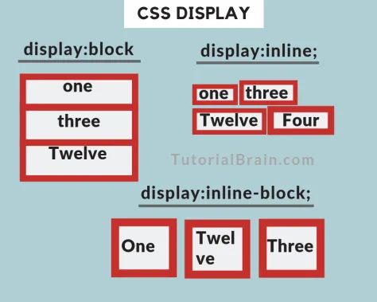
HTML arrange
It is important to understand how the browser arranges the elements on the screen.
Check this tutorial where it explains the different ways an element can be arranged on the screen.
You can change the way elements are arranged using the display property:
div { display: inline-block; }
Also check the property float.

Slide 38
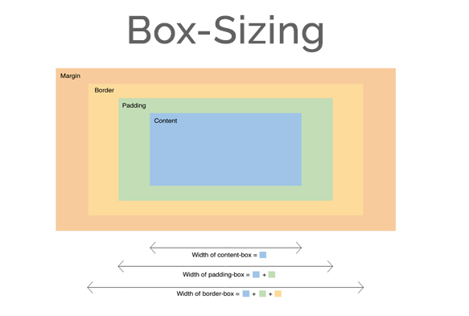
Box Model
It is important to note that by default any width and height specified to an element will not take into account its margin, so a div with width 100px and margin 10px will measure 120px on the screen, not 100px.
This could be a problem breaking your layout.
You can change this behaviour changing the box model of the element so the width uses the outmost border:
div { box-sizing: border; }

Slide 39
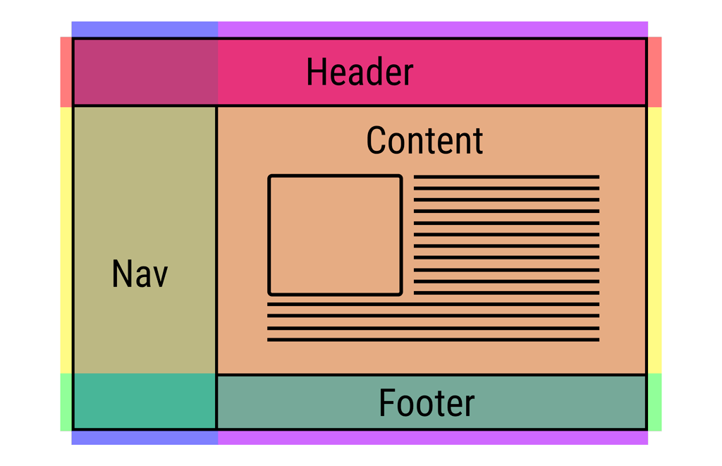
Layout
One of the hardest parts of CSS is construing the layout of your website (the structure inside the window) .
By default HTML tends to put everything in one column, which is not ideal.
There has been many proposals in CSS to address this issue (tables, fixed divs, flex, grid, …).

Slide 40
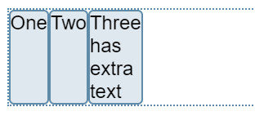
Flexbox
The first big proposal to address the layout was the flexbox model.
This model allows to arrange stuff in one direction (vertically or horizontally) very easily.
You can even choose to arrange from right to left (reverse).
It can also be used to arrange a series of elements in different rows.
Check the tutorial for more info.
HTML
<div class="box">
<div>One</div>
<div>Two</div>
<div>Three
<br>first line
<br>second line
</div>
</div>
CSS
.box {
display: flex;
}

Slide 41
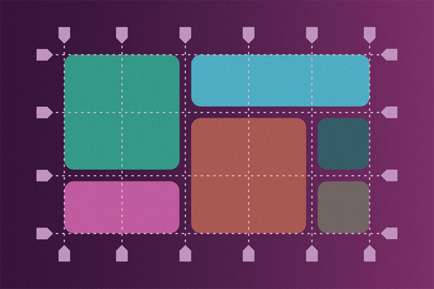
Grid system
HTML
<div class="grid-container">
<div class="grid-item1">1</div>
<div class="grid-item2">2</div>
</div>
CSS
.grid-container {
display: grid;
grid-template-rows: 100px 100px;
grid-template-columns: 100px 100px 100px;
grid-gap: 5px;
}
.grid-item1 {
background: blue;
border: black 5px solid;
grid-column-start: 1;
grid-column-end: 5;
grid-row-start: 1;
grid-row-end: 3;
}
Because most sites are structured in a grid, I recommend to use the CSS Grid system.
We just assign how many rows/columns a div should use from the main grid and it will arrange automatically.

